Slide 1

Project Title:
TrekPal
Department of Computer Science
COMSATS University Islamabad, Abbottabad Campus
Group Members:
Hashim Ali Khan (FA22-BSE-)
Ali Usman Tajik (FA22-BSE-)
Supervisor-name:
Maam Sana malik

Slide 2
Agenda of the Presentation
Brief Introduction
Scope
Functional Requirements
Non-Functional Requirements
User Goals
Use Cases
Use Case Diagram
Class Diagram
Sequence Diagram
Activity/State Machine Diagram
ER Diagram
Package Diagram
Deployment Diagram
Decision Table
Schedule (Gantt Chart)
Tasks for 1st Iteration(or 30%)
Details of 2nd Iteration (60%)
Conclusion

Slide 3
Brief Introduction
TrekPal is a multi-platform travel management and marketplace system developed to simplify and modernize trip planning.
The project connects travelers, travel agencies, hotels, and administrators in one unified digital ecosystem.
It addresses the problem of fragmented travel planning, where users normally rely on separate platforms or informal communication for hotels, transport, and travel packages.
A key feature of TrekPal is its trip request and bidding model, where travelers create trip requests and agencies respond with customized offers.
The system includes a Flutter traveler app, React-based agency portal, hotel portal, and admin portal, all connected to a centralized backend.
The backend is built using Node.js, Express, TypeScript, Prisma, and Supabase PostgreSQL.

Slide 4
Scope
Provide a traveler mobile application for trip requests, bid viewing, package browsing, bookings, chat, and profile management.
Provide an agency portal for managing hotels, rooms, vehicles, packages, trip offers, and bookings.
Provide a hotel portal for managing room types, services, and booking activity.
Provide an admin portal for verification, approval, monitoring, and system-level control.
Implement a trip request and bidding mechanism that allows travelers to receive customized offers from agencies.

Slide 5
Scope(cont)
Support hotel, vehicle, and package management within the platform.
Enable booking creation and booking status tracking for multiple travel services.
Implement real-time communication and updates for chat and marketplace events.
Provide authentication, KYC verification, and role-based access control for secure platform usage.
Use a centralized backend and relational database to manage all business logic and data consistently.

Slide 6
Functional Requirements
Traveler Functional Requirements
Traveler Registration and Login: Allows travelers to create an account and securely access the TrekPal platform.
Traveler Verification: Enables travelers to submit KYC and identity details for approval.
Browse Hotels and Packages: Allows travelers to explore available hotels and travel package offerings.
Create Trip Request: Enables travelers to define trip needs such as destination, dates, and budget.
View and Accept Bids: Allows travelers to review agency offers and accept the most suitable one.
View Bookings: Enables travelers to track their confirmed and past booking records.
Group Trip Participation: Allows travelers to join trip groups.
Submit Review: Enables travelers to provide feedback and ratings after completing a trip or booking.

Slide 7
Functional Requirements(Cont.)
Agency Functional Requirements
Agency Registration: Allows travel agencies to create a portal account and join the platform.
Agency Verification: Enables agencies to submit business and legal documents for approval.
Manage Hotels: Allows agencies to add, update, and manage hotel listings.
Manage Rooms and Food Menus: Enables agencies to maintain room-related details and associated service/menu data.
Manage Vehicles: Allows agencies to register and update transport inventory.
Manage Vehicle Availability: Enables agencies to control vehicle availability for travel operations.
View Trip Requests: Allows agencies to view traveler trip requests that are open for bidding.

Slide 8
Functional Requirements(Cont.)
Hotel Portal Functional Requirements
Hotel Registration: Allows hotels to register and gain access to the hotel management portal.
Manage Rooms and Services: Enables hotels to create and update room types and hotel service offerings.
View Booking Activity: Allows hotels to monitor bookings associated with their rooms and services.

Slide 9
Functional Requirements(Cont.)
Admin Functional Requirements
Approve/Reject Agency Registration: Allows administrators to review and decide agency approval requests.
Approve/Reject Hotels: Enables administrators to control which hotel entries are accepted into the platform.
Approve/Reject Vehicles: Allows administrators to review and approve or reject vehicle submissions.
Approve Traveler Verification: Enables administrators to validate and approve traveler KYC submissions.
Content Moderation: Allows administrators to oversee and control platform content for quality and compliance.

Slide 10
Non-Functional Requirements
Usability Requirements
NFR-USE-01 — Simple & Intuitive UI
The system shall provide a clean and easy-to-navigate interface on both mobile and web.
NFR-USE-02 — Clear Feedback
Users shall receive meaningful success/error messages.
NFR-USE-03 — Easy Onboarding
Registration and login shall be completed within a few simple steps.
Reliability Requirements
NFR-REL-01 — High Availability
The system shall maintain 99% uptime.
NFR-REL-02 — Prevent Double Booking
The system shall ensure no hotel room or vehicle can be double-booked.
Performance Requirements
NFR-PERF-01 — Fast Response
Search results and main screens shall load within 2–3 seconds.
NFR-PERF-02 — Scalable User Load
The system shall support large numbers of active users without performance degradation.

Slide 11
User Goals
Find a simple and centralized way to plan and manage complete trips.
Compare multiple travel offers and choose the most suitable option.
Access verified hotels, agencies, and transport providers with greater trust.
Manage bookings, trip updates, and communication in one unified platform.
Save time and effort by reducing the need for manual coordination across multiple services.

Slide 12
Use Cases
Traveler Use Cases
UC-1 Register / Login
UC-2 Verification
UC-3 Hotel Search
UC-4 Create Trip Request
UC-5 View and Accept Bids
UC-6 View Bookings
UC-7 Join Group Trip
UC-8 Submit Review

Slide 13
Use Cases(cont)
Agency Use Cases
UC-9 Register Travel Agency
UC-10 Submit Verification Documents
UC-11 Manage Hotels, Rooms, and Vehicles
UC-12 View Trip Requests
UC-13 Submit Bids
UC-14 Manage Bookings
UC-15 Create Tour Packages

Slide 14
Use Cases(cont)
Admin Use Cases
UC-16 Approve/Reject Agency Registration
UC-17 Approve/Reject Hotel
UC-18 Approve/Reject Vehicle
UC-19 Approve Traveler Verification
UC-20 View System Analytics

Slide 15
Use Cases(cont)
Hotel Use Cases
UC-21 Register Hotel
UC-22 Manage Rooms and Services
UC-23 View Booking Activity

Slide 16
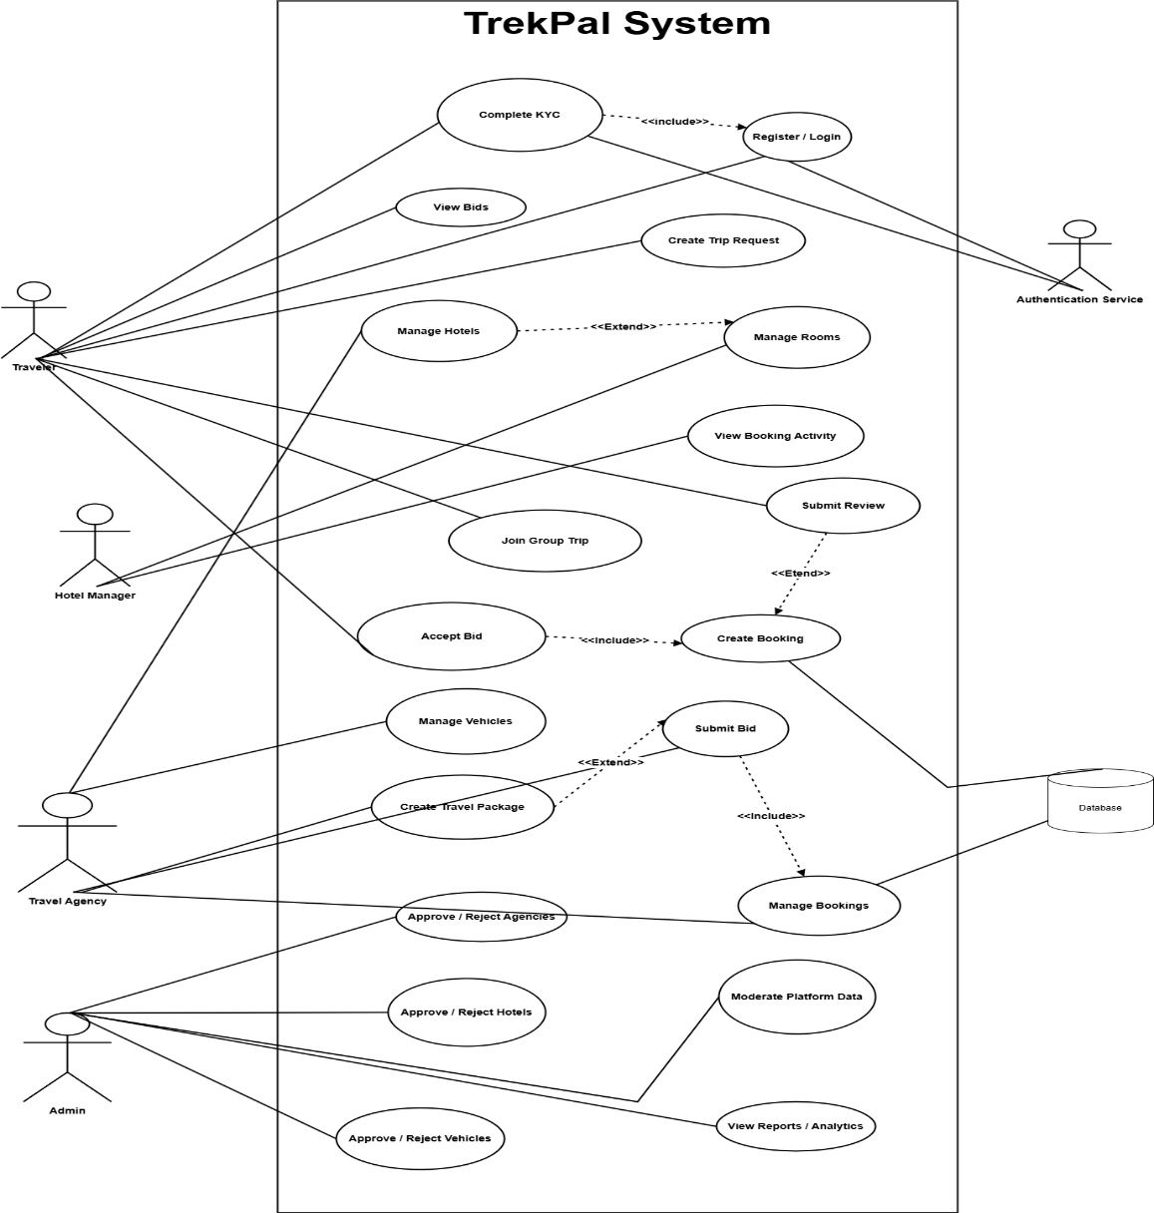
Use Case Diagram

Slide 17
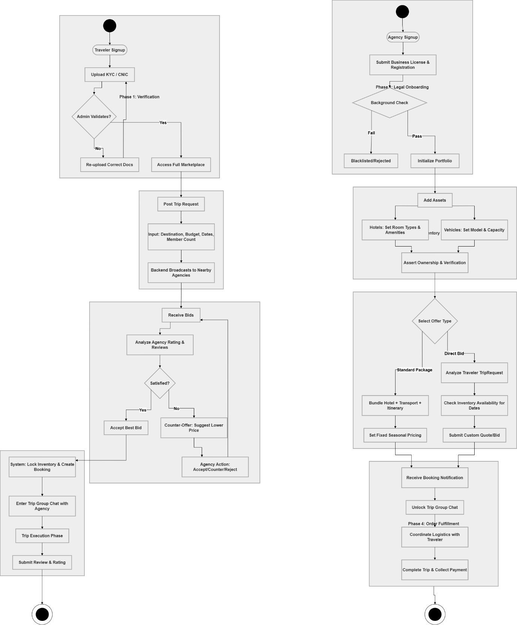
Process flow Diagram
Traveler flow

Slide 18
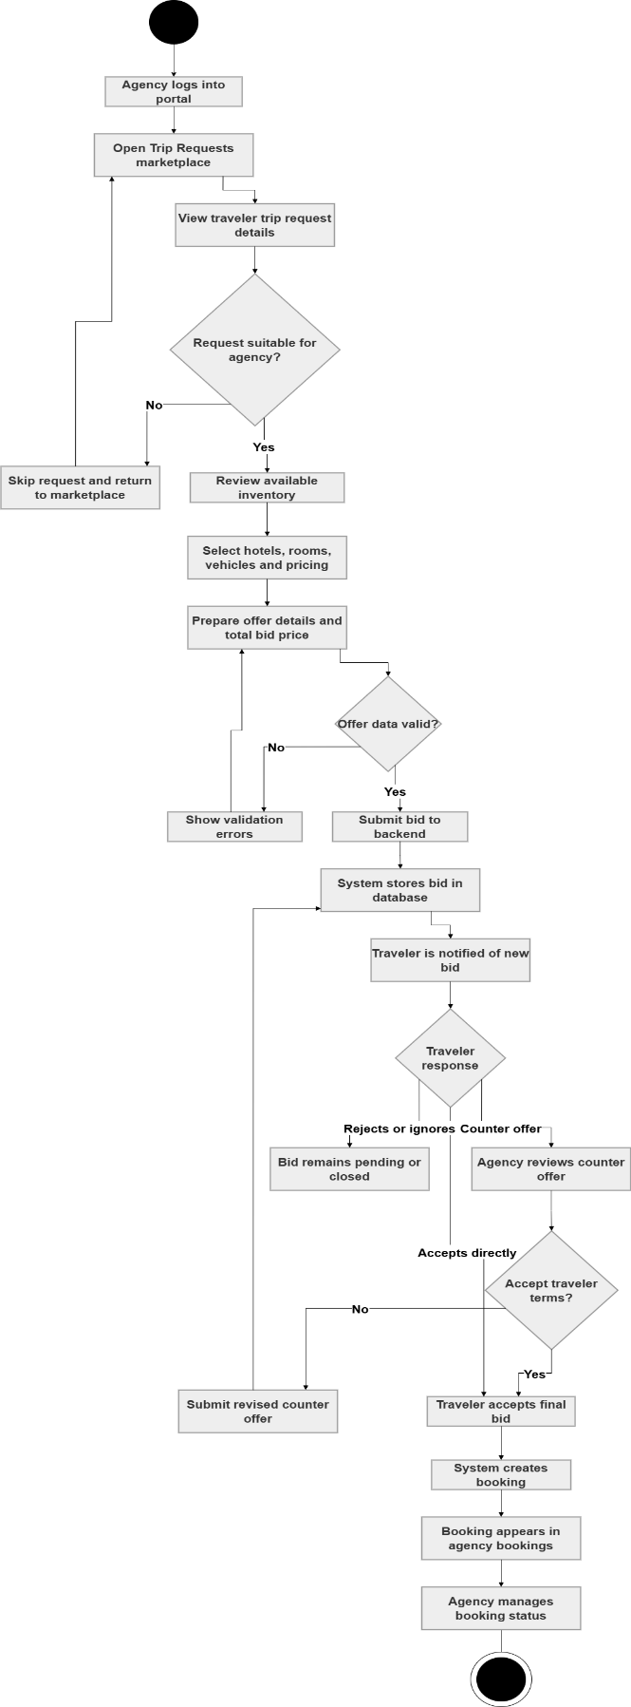
Process Flow Diagram
Agency Flow

Slide 19
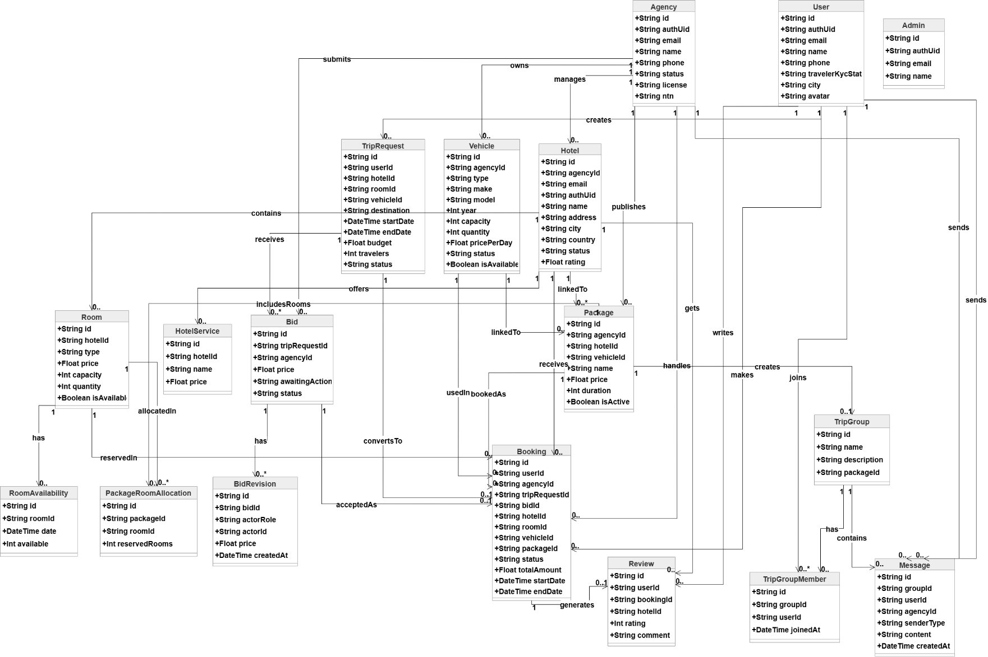
Class Diagram

Slide 20
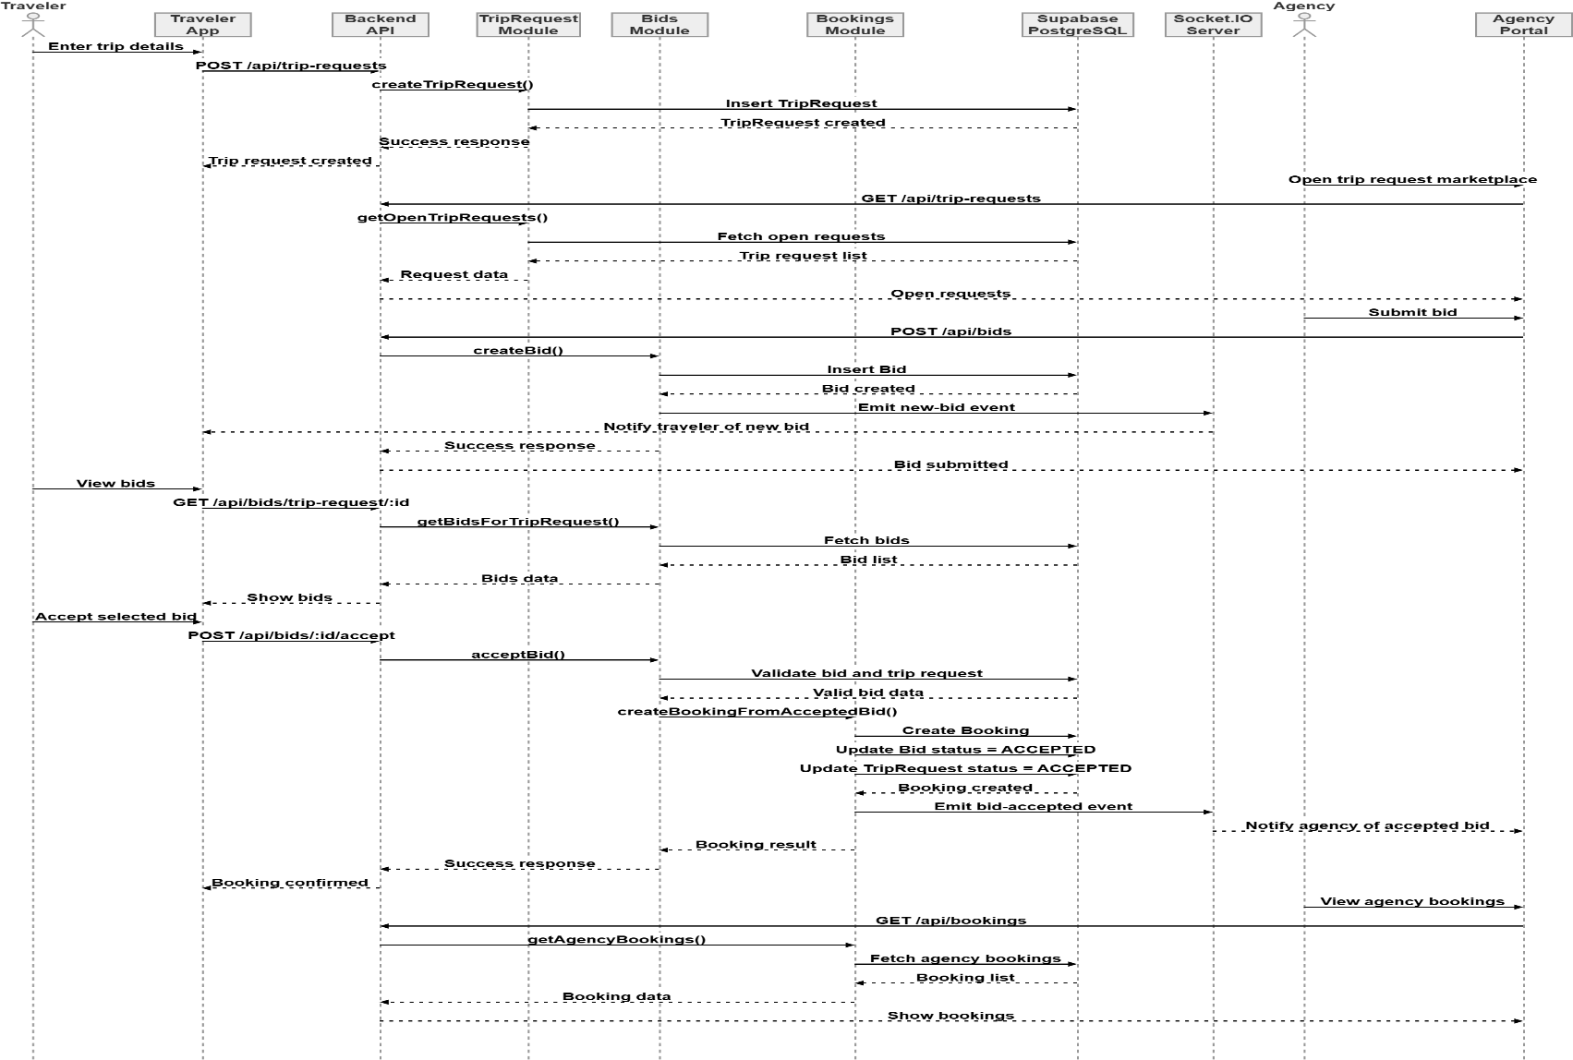
Sequence Diagram

Slide 21
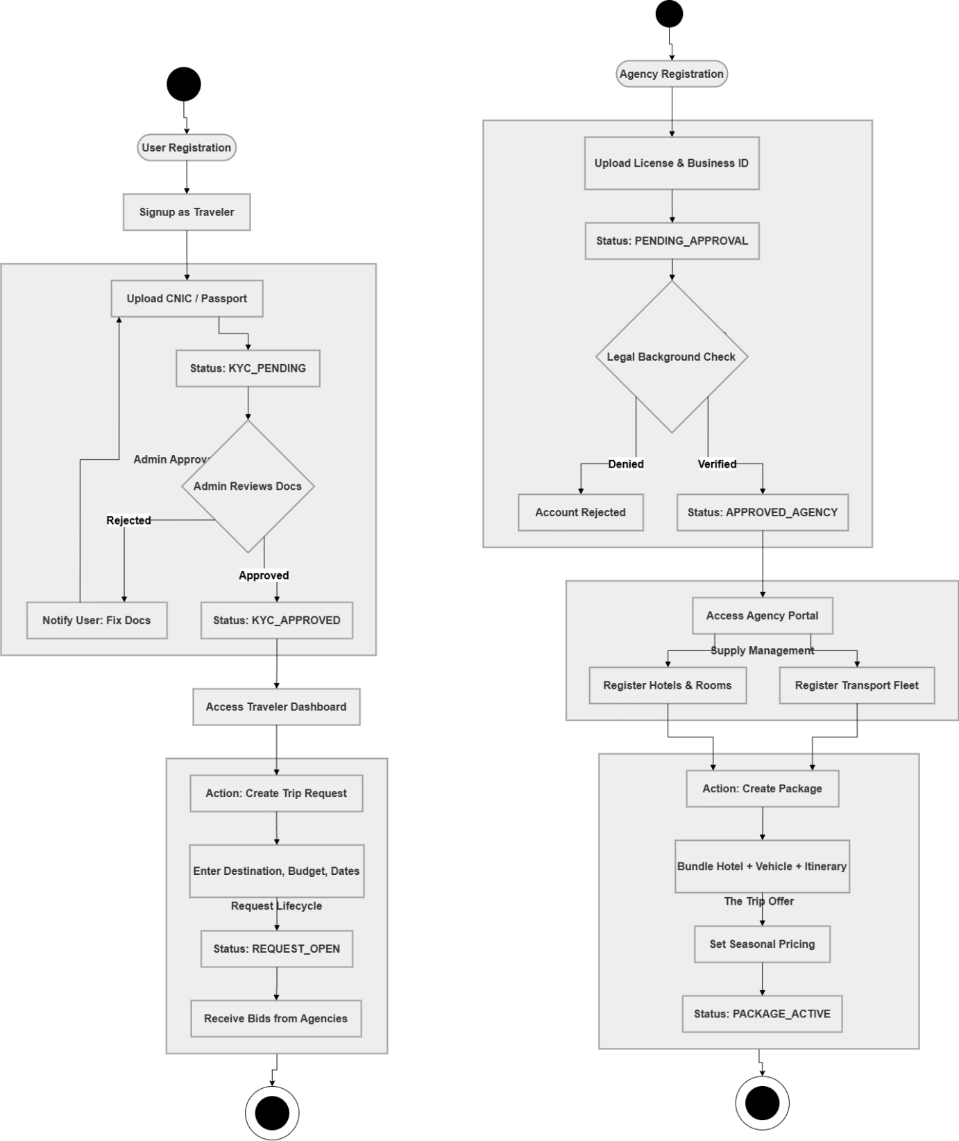
Activity/State Machine Diagram

Slide 22
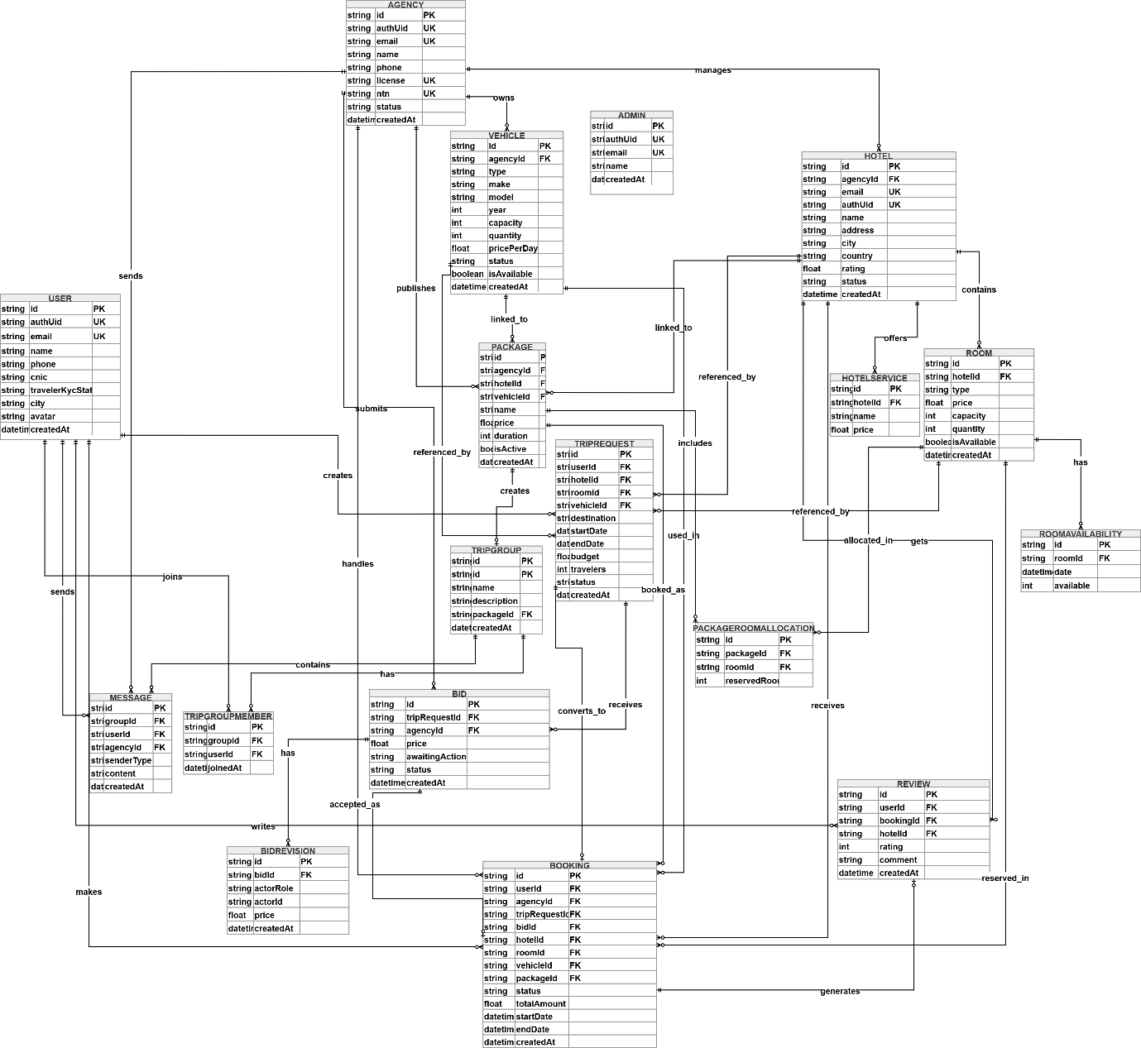
ER Diagram

Slide 23
Summary of Project Implementation
Multi-role platform architecture: TrekPal is designed as a unified ecosystem with separate interfaces for travelers, travel agencies, hotels, and administrators, so each user type can perform tasks relevant to their role.
Traveler mobile application: Travelers can register, complete verification, search hotels and packages, create trip requests, view and accept bids, manage bookings, join group trips,
Trip request and bidding system: Instead of relying only on fixed listings, travelers can define their travel needs such as destination, dates, and budget, while agencies respond with customized offers, making the planning process more flexible and competitive.
Agency portal management: Travel agencies can register, submit verification documents, manage hotels, rooms, transport vehicles, create travel packages, view open trip requests, submit bids, and manage accepted bookings through a dedicated web portal.
Hotel portal management: Hotels have their own portal where they can register, manage room types, manage hotel services, and monitor booking activity related to their property.

Slide 24
Summary of Project Implementation (cont.)
Admin control and verification: The admin portal supports approval and rejection of agencies, hotels, vehicles, and traveler verification requests, ensuring trust, quality control, and governance across the platform.
Booking management: TrekPal supports the creation, tracking, and updating of bookings, allowing users and service providers to monitor trip progress and service status.
Real-time communication: The system includes live updates, which improve coordination between travelers and agencies, especially for bids, group trips, and booking-related communication.
Inventory and package management: Hotels, rooms, vehicles, and packages are managed centrally so agencies and hotels can maintain up-to-date listings and availability.
Secure and scalable backend: The project uses a centralized backend with authentication, role-based authorization, Prisma ORM, and Supabase PostgreSQL, making the platform structured, secure, and extensible for future enhancements.

Slide 25
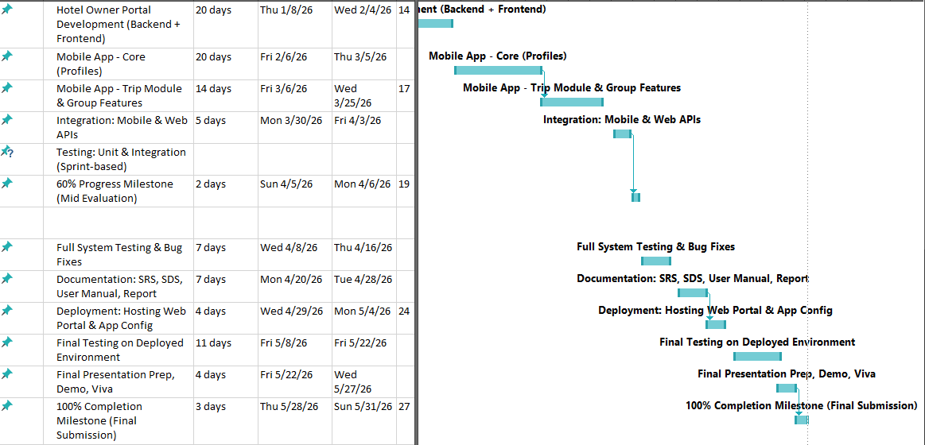
Schedule

Slide 26
Details of next Iteration (100%)
Notification System
notifications for new bids, booking confirmations, approvals, and trip updates
In-app notification center
Advanced Search and Filtering
Hotel filtering by price, city, amenities, and rating
Vehicle filtering by type, price, and seat capacity
Package search with destination/date filters

Slide 27
Details of next Iteration (100%)
Full Chat and Communication Completion
Complete chat UI/UX across all relevant platforms
Better group trip coordination tools
Booking Workflow Completion
Detailed booking management screens for all actors
Cancellation policy handling

Slide 28
Details of next Iteration (100%)
Review and Complaint Management
Complaint reporting system
Admin review moderation
Dispute resolution workflow
Deployment and Production Hardening
Move file storage from local uploads to cloud storage
Better security hardening
Full testing, validation, and performance optimization
CI/CD and backup/recovery readiness

